Slide 1
NAME : GOPALAKRISHNAN T
ROLL NO : 813821104302

Slide 2
Face detection using neural networks
INTRODUCTION
Face detection using neural networks is a popular approach in computer vision, particularly in the field of facial recognition and biometrics. Neural networks offer the ability to learn complex patterns and features from images, making them well-suited for tasks like detecting and recognizing faces.

Slide 3


AGENDA
1. DataCollection
2. Preprocessing
3. Labeling
4. Model Architecture Selection
5. Training
6. Evaluation
7. Testing
8. Deployment
3/21/2024 Annual Review

Slide 4

PROBLEM STATEMENT
Develop an accurate and efficient face detection system capable of identifying human faces in images or video frames.

Slide 5

PROJECT OVERVIEW
The task involves designing and implementing a computer vision system that can automatically detect and localize human faces within digital images or video streams. The system should be robust to variations in lighting conditions, facial expressions, poses, and occlusions. The primary goal is to accurately identify the presence and location of faces within the input data.

Slide 6

WHO ARE THE END USERS?
1.Law Enforcement and Security 2.AgenciesBorder Control and 3.Immigration AuthoritiesRetail and 4.Marketing CompaniesFinancial 5.InstitutionsHealthcare 6.ProvidersEducational 7.InstitutionsEntertainment 8.IndustryTransportation and Travel 9.IndustrySmart Homes and Internet of Things (IoT) Device
10.Social Media Platforms and Mobile Applications
11.Human Resources and Workforce Management
12.Event Organizers and Venue Managers

Slide 7

YOUR SOLUTION AND ITS VALUE PROPOSITION
Define the Problem:
Clearly articulate the problem statement and the specific requirements for face detection. Identify the key objectives, such as real-time detection, accuracy, scalability, and any constraints such as hardware limitations or privacy concerns.
Choose a Technology Stack: Select appropriate tools, libraries, and frameworks based on the requirements of the application. Consider factors such as programming language compatibility, support for machine learning algorithms, and integration capabilities with existing systems.
Data Collection and Preprocessing: Gather a diverse dataset of face images representative of the target population and conditions. Preprocess the data by standardizing image sizes, adjusting lighting conditions, and augmenting the dataset to improve model generalization.

Slide 8
Model Selection: Choose a suitable face detection model based on the application requirements. Options include traditional computer vision methods like Haar cascades, deep learning approaches such as Convolutional Neural Networks (CNNs), or pre-trained models like Single Shot Multibox Detector (SSD) or Faster R-CNN.
Training and Optimization: Train the selected model using the preprocessed dataset. Optimize the model hyperparameters, such as learning rate, batch size, and network architecture, to improve performance. Utilize techniques like transfer learning to leverage pre-trained models and accelerate training.
Evaluation and Testing: Evaluate the trained model on a separate test dataset to assess its accuracy, precision, recall, and F1 score. Conduct performance testing to measure inference speed and resource utilization. Iteratively refine the model based on evaluation results.

Slide 9
Ethical Considerations: Address ethical concerns related to privacy, data security, bias, and fairness in face detection. Implement privacy-preserving techniques such as anonymization, consent management, and encryption to protect user data and mitigate potential risks.
Documentation and Maintenance: Document the solution architecture, implementation details, and deployment procedures for future reference. Establish a maintenance plan to monitor model performance, update dependencies, and address emerging security threats or regulatory changes.
User Training and Support: Provide user training and support to stakeholders involved in deploying and using the face detection system. Offer resources, tutorials, and troubleshooting guidance to ensure effective adoption and utilization of the technology.

Slide 10


MODELLING

Slide 11


Slide 12
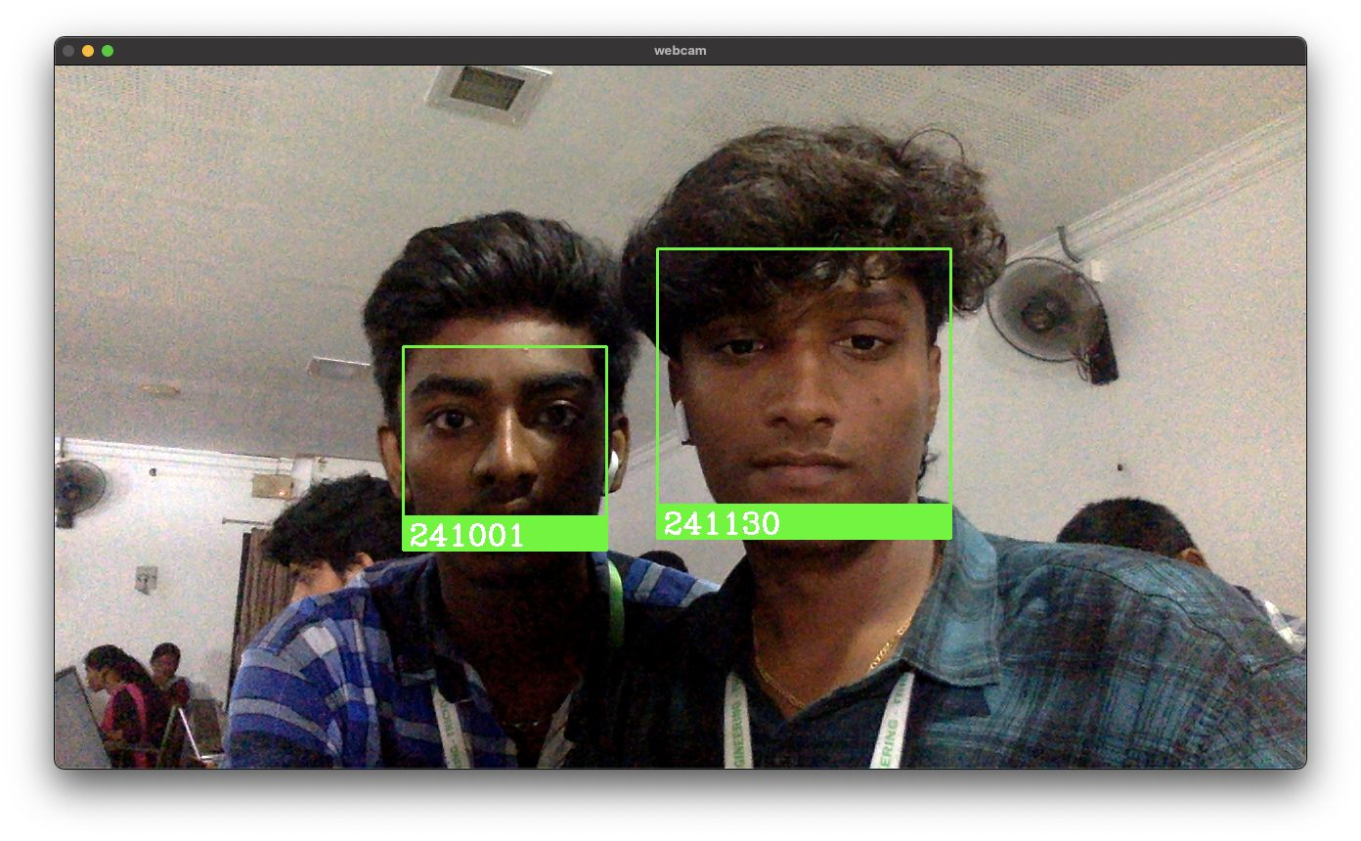
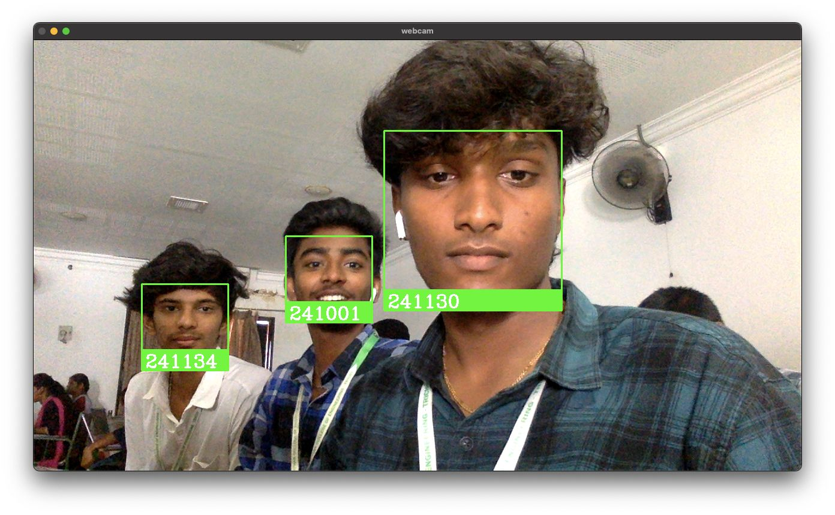

Slide 13
RESULTS
Detection Accuracy: The system should accurately identify and localize faces in different settings, lighting conditions, and orientations. This includes detecting faces at various scales and angles.
Real-time Processing: The system should be capable of processing frames from a video feed in real-time, providing timely detection results.
Robustness: The system should be robust to variations in facial expressions, poses, occlusions (e.g., by glasses or hats), and environmental factors (e.g., lighting changes, background clutter).
Efficiency: The system should be efficient in terms of computational resources, allowing it to run smoothly on different hardware platforms, including desktop computers, mobile devices, and embedded systems.
Minimal False Positives/Negatives: The system should minimize false positives (incorrectly identifying non-faces as faces) and false negatives (failing to detect actual faces). Achieving a balance between sensitivity and specificity is crucial.
Demo Link

